Slide 1
Big Mountain Resort Case Study
Brody Hill

Slide 2
What question are we answering?
Our primary focus is how this…
How can Big Mountain Resort maximise their returns, relative to their market position, through identification of which facilities are most important to consumers?

Slide 3
What's the current state?
Big Mountain is unsure if their current ticket prices are taking full advantage of their market position based on two primary reasons:
They are unsure which of their facilities matter most to consumers, aka which facilities consumers are most likely to pay for.
They are unsure how their facilities compare to competitors.

Slide 4
My Recommendation
Given Big Mountains Market dominant position in four key facilities: Fast Quads, Runs, Snow Making Area, and Vertical drop…
My recommendation is increasing ticket price by $9.90, through implementation of scenario three, that being adding one run, increasing vertical drop by 150 feet, installing an additional lift, and adding two acres of snow making.
Notes:
Here, I would point to my comparison figures, showing Big Mountain does indeed hold a dominant position in most key features.

Slide 5
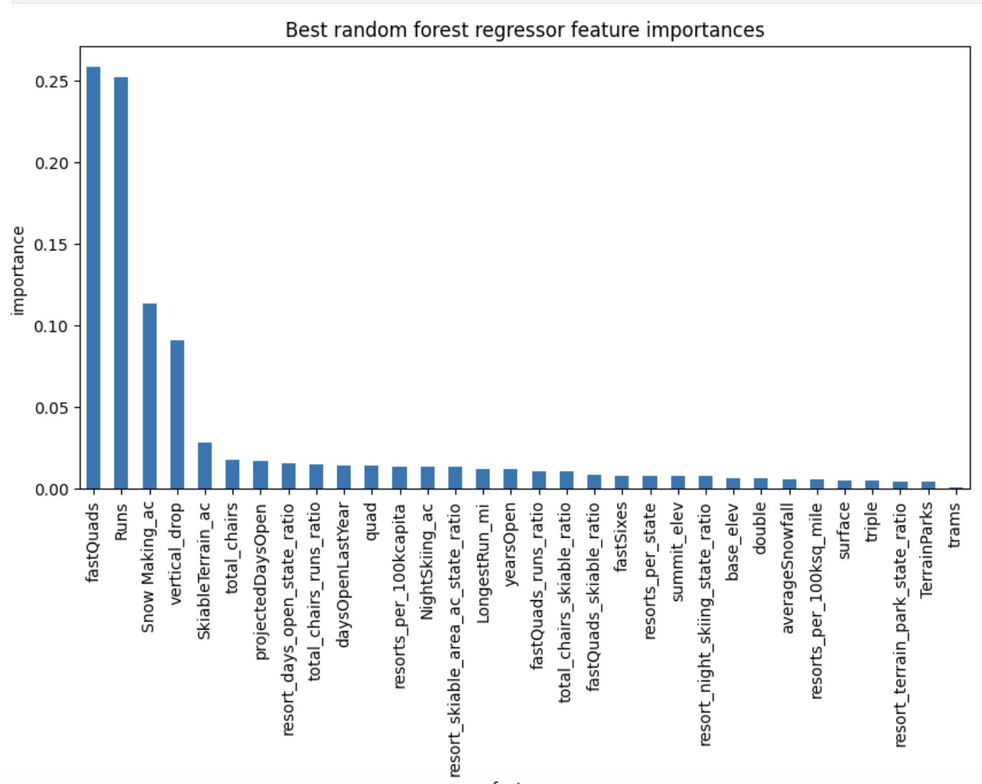
How did I get there?
Notes:
NOTES (what I would say when presenting this slide): First, I Identified which features matters most to consumers (aka, which facilities most impacted ticket price) through a machine learning model. I then compared how Big Mountain compares to competitors in these key features.

Slide 6
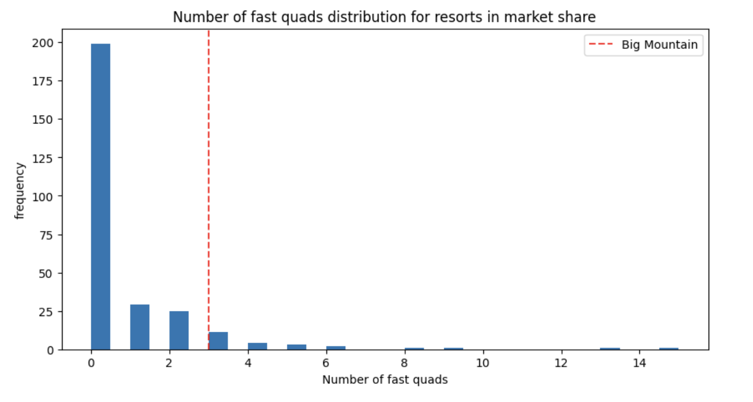
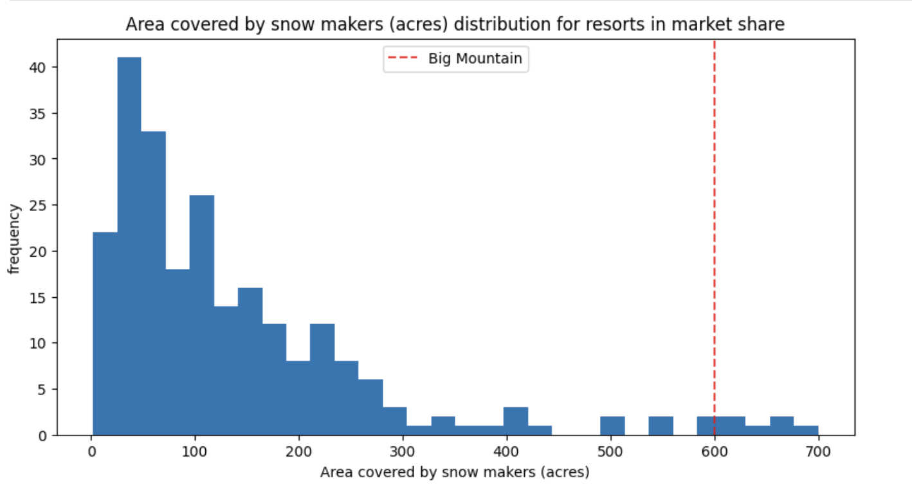
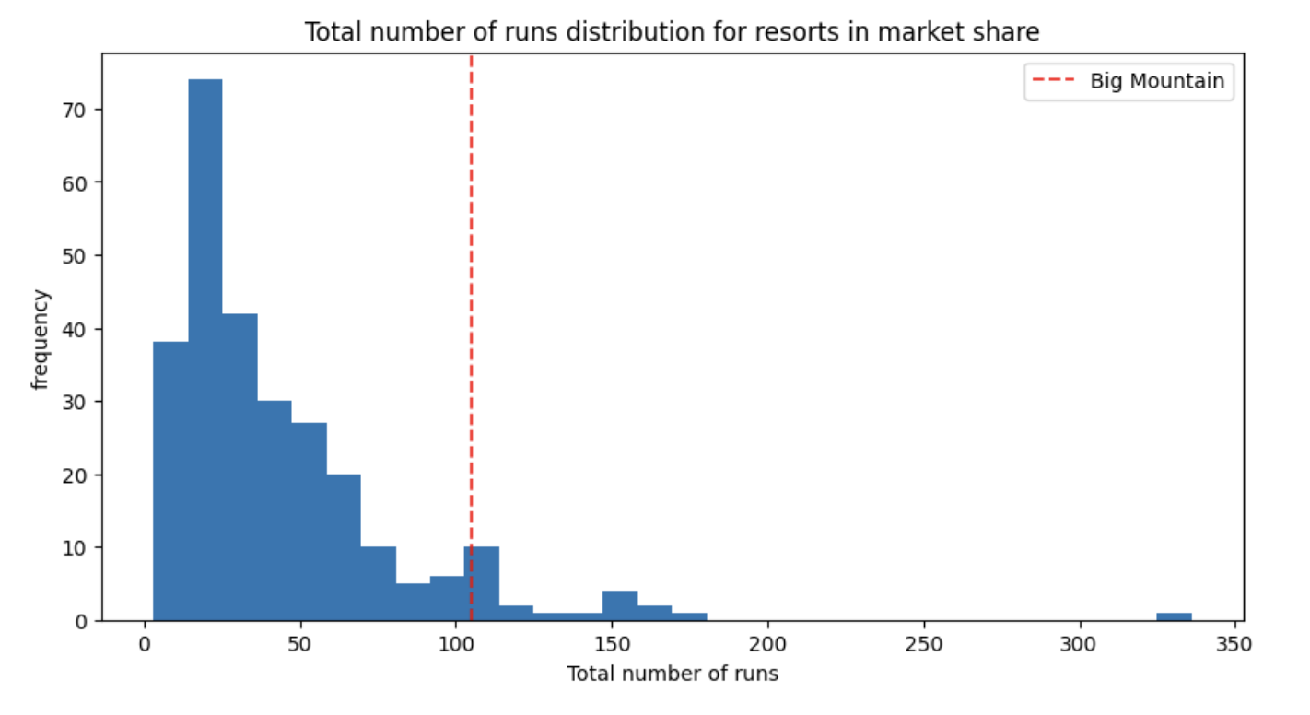
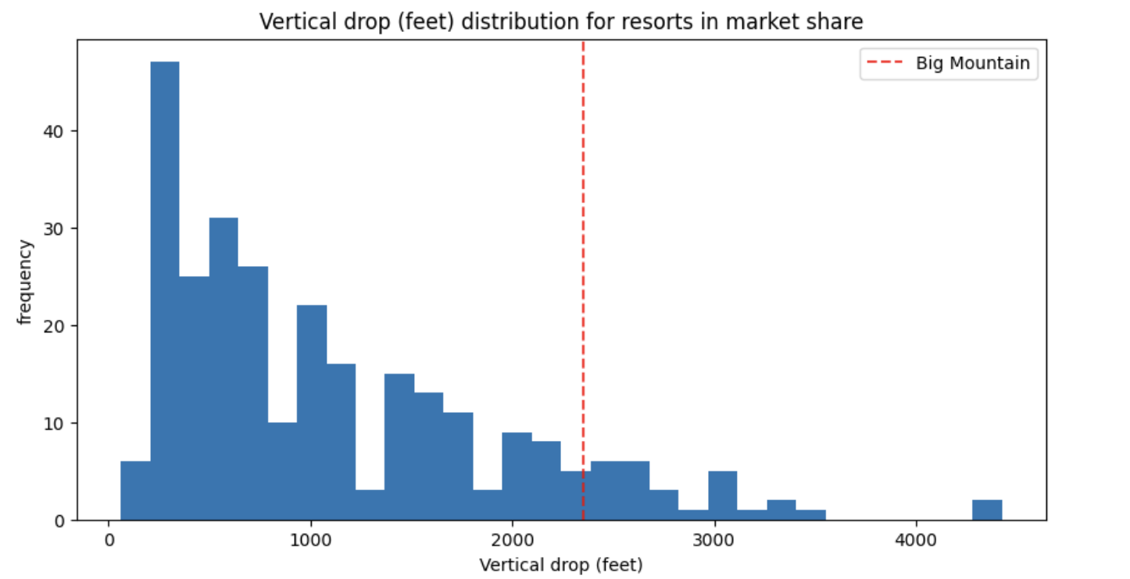
Notes:
NOTE: Showing Market Share in top metrics

Slide 7
How did I get there? (part two)
Through this understanding of which features are most important to consumers and after comparing how Big Mountain stacks up against competitors…
I could use the machine learning model I created, with these features in mind, in combination with the proposed changes to suggest how ticket price could increase or decrease in response.

Slide 8
Scenario Three
Looking at scenario three’s proposed changes in three key features ( run number, vertical drop and snow making area), the model suggests a $10 increase to ticket price could be supported.
Positive changes (adding a run, increasing drop, creating more snow making area) to features most important to consumers allow a positive increase to ticket price.
Notes:
NOTE: I know scenario 3 proposes 4 changes, but the 4th change, adding a ski lift, was not a top feature.

Slide 9
Conclusion
These changes will need to be measure in comparison to the cost of implementing them.
This model and ability to predict proposed changes can be easily taught. My final recommendation would be a few days to teach the Big Mountain Team how to use it, so further changes can be made with confidence in the seasons to come, without my presence.
Notes:
When I say easily taught, I mean using the final model and our predict increase function, the syntax on how to use them can be easily taught in my opinion.

